Slide 1
CONSUMERS, PRODUCERS, AND MARKET EQUILIBRIUM

Slide 2

Revisiting the market equilibrium
Do the equilibrium price and quantity maximize the total welfare of buyers and sellers?
Market equilibrium reflects the way markets allocate scarce resources.

Slide 3
Welfare Economics
  Study of how the allocation of resources and goods affects social welfare
  Equilibrium in the market results in maximum benefits, and therefore maximum total welfare for both the consumers and the producers of the product.

Slide 4
Welfare Economics
Consumer surplus measures economic welfare from the buyer’s side.
Producer surplus measures economic welfare from the seller’s side.

Slide 5
Consumer surplus
  Willingness to pay is the maximum amount that a buyer will pay for a good.
  It measures how much the buyer values the good or service.
  Consumer surplus is the buyer’s willingness to pay for a good minus the amount the buyer actually pays for it.

Slide 6

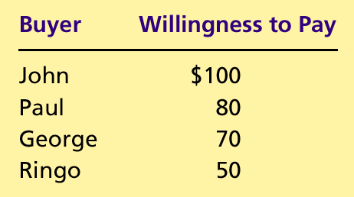
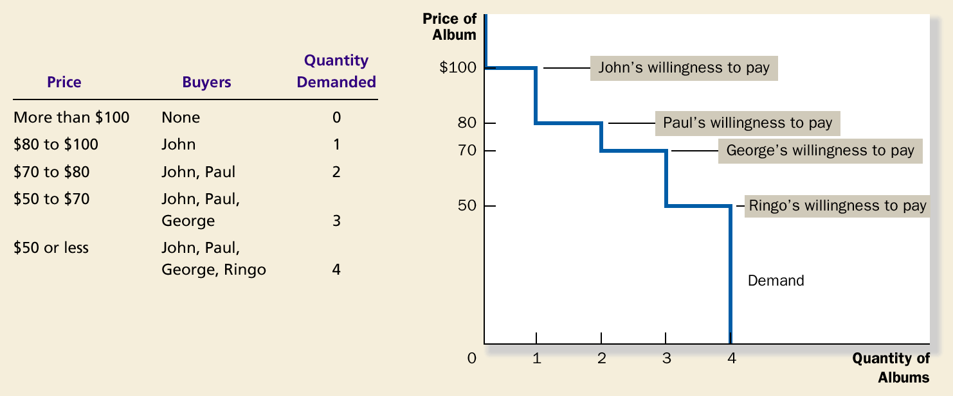
Four Possible Buyers’ Willingness to Pay

Slide 7

The Demand Schedule and the Demand Curve
Price of
Album
$100
John
’
s willingness to pay
80
Paul
’
s willingness to pay
70
George
’
s willingness to pay
50
Ringo
’
s willingness to pay
Demand
0
1
2
3
4
Quantity of
Albums

Slide 8
Measuring Consumer Surplus with the Demand Curve
(a) Price = $80
Price of
Album
$100
John
’
s consumer surplus ($20)
80
70
50
Demand
0
1
2
3
4
Quantity of
Albums

Slide 9
Measuring Consumer Surplus with the Demand Curve
(b) Price = $70
Price of
Album
$100
John
’
s consumer surplus ($30)
80
Paul
’
s consumer
70
surplus ($10)
Total
50
consumer
surplus ($40)
Demand
0
1
2
3
4
Quantity of
Albums

Slide 10
Consumer Surplus: A generalized view
(a) Consumer Surplus at Price
P
Price
A
Consumer
surplus
P₁
B
C
Demand
0
Q₁
Quantity

Slide 11
How the Price Affects Consumer Surplus
(b) Consumer Surplus at Price
P
Price
A
Initial
consumer
surplus
P₁
C
Consumer surplus
B
to new consumers
P₂
F
D
E
Additional consumer
Demand
surplus to initial
consumers
0
Q₁
Q₂
Quantity

Slide 12
Producer surplus
  Producer surplus is the amount a seller is paid for a good minus the seller’s cost.
  It measures the benefit to sellers participating in a market.

Slide 13
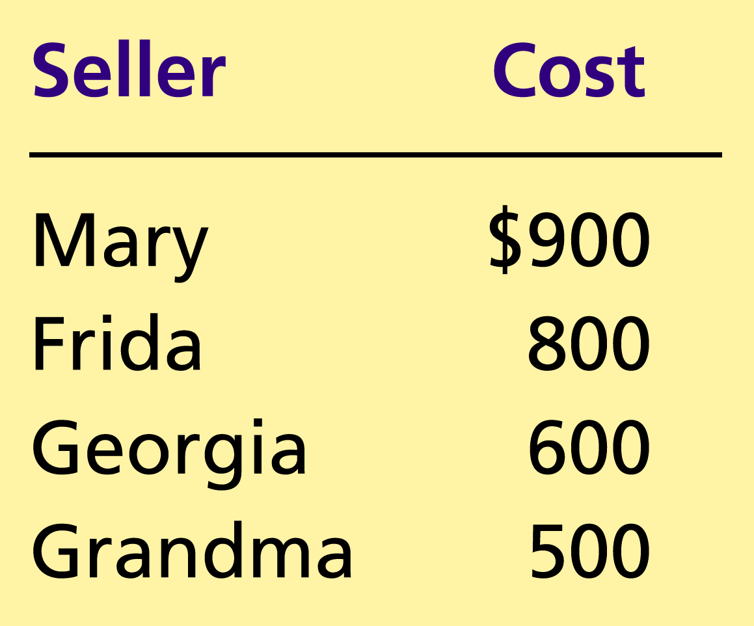
The Costs of Four Possible Sellers
Copyright©2004 South-Western

Slide 14
Using the Supply Curve to Measure Producer Surplus
Just as consumer surplus is related to the demand curve, producer surplus is closely related to the supply curve.

Slide 15
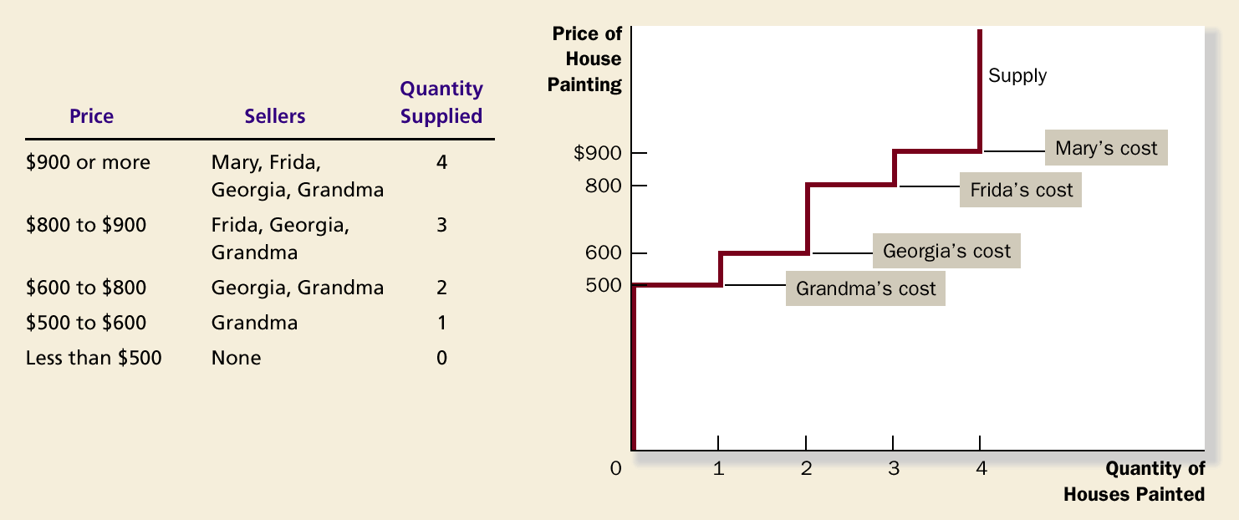
The Supply Schedule and the Supply Curve

Slide 16
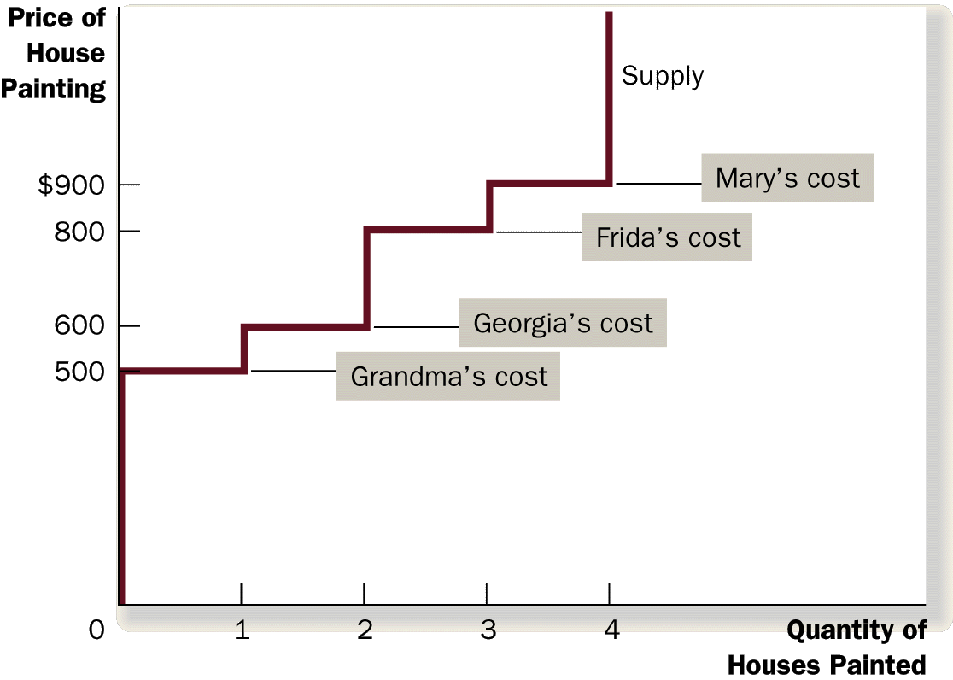
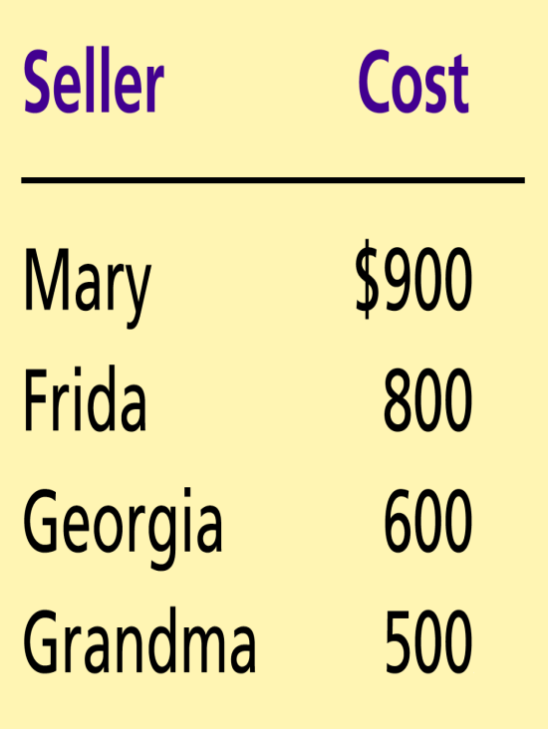
The Supply Schedule and the Supply Curve

Slide 17
Measuring Producer Surplus with the Supply Curve
(a) Price = $600
Price of
House
Painting
Supply
$900
800
600
500
Grandma
’
s producer
surplus ($100)
0
1
2
3
4
Quantity of
Houses Painted
Copyright©2003 Southwestern/Thomson Learning

Slide 18
Measuring Producer Surplus with the Supply Curve
(b) Price = $800
Price of
House
Painting
Supply
Total
producer
$900
surplus ($500)
800
600
Georgia
’
s producer
500
surplus ($200)
Grandma
’
s producer
surplus ($300)
0
1
2
3
4
Quantity of
Houses Painted

Slide 19
Producer Surplus: A generalized view
(a) Producer Surplus at Price
P
Price
Supply
P₁
B
C
Producer
surplus
A
0
Q₁
Quantity

Slide 20
How the Price Affects Producer Surplus
(b) Producer Surplus at Price
P
Price
Additional producer
Supply
surplus to initial
producers
D
E
P₂
F
P₁
B
Initial
C
Producer surplus
producer
to new producers
surplus
A
0
Q₁
Q₂
Quantity

Slide 21
Consumer and Producer Surplus in the Market Equilibrium
Price
A
D
Supply
Consumer
surplus
Equilibrium
E
price
Producer
surplus
Demand
B
C
0
Equilibrium
Quantity
quantity

